Slide 1

EXPLORING NOVEL CRYPTOGRAPHIC METHODS FOR SECURE KEY GENERATION Hayal İldeniz İnanç 2100005804 Özge Küçükbayram 2000004664 Bilge Demir 2000003445
ADVISOR: Assis. Prof. Dr. Öznur Şengel

Slide 2
INTRODUCTION
This project aims to provide users with strong, secure yet memorable passwords by using meaningful emojis based on input text.
Our goal is to create strong and memorable passwords with emojis that match the meaning of the words.
User input is analyzed with Natural Language Processing (NLP) techniques to determine the subject, verb and object.
Passwords are created with semantically matching emojis.
A password option consisting of classic characters is also offered according to user preferences.
Password security is measured with various tests, the cracking time is calculated, and feedback is given to the user.
The system is web-based and provides flexible password generation.

Slide 3
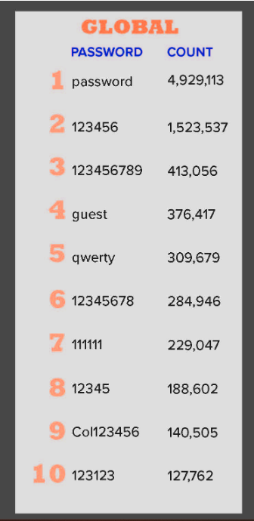
Why Do We Need Better Passwords?
Problem Overview
Most users reuse weak, predictable passwords like "123456" or their birthdate.
Complex passwords are secure but difficult to remember.
Weak passwords are vulnerable to attacks.
Security Challenges
Human memory limitations conflict with secure password policies.
This creates a trade-off:
Strong passwords are forgotten.
Memorable passwords are weak.

Slide 4
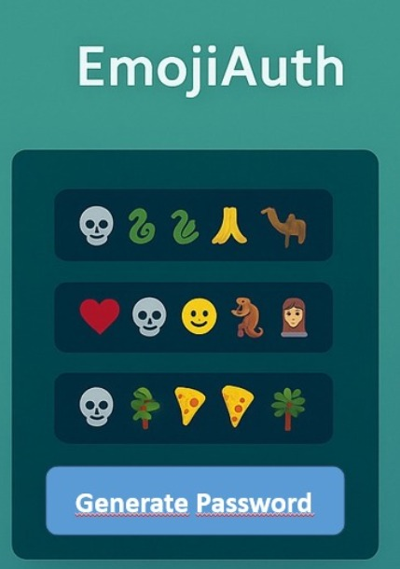
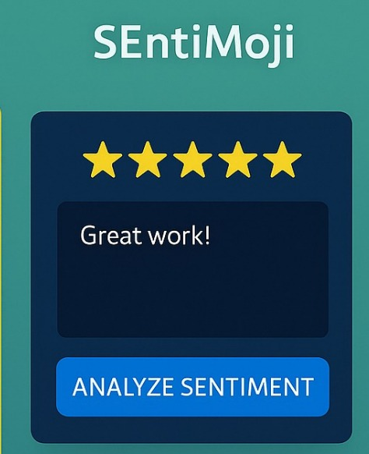
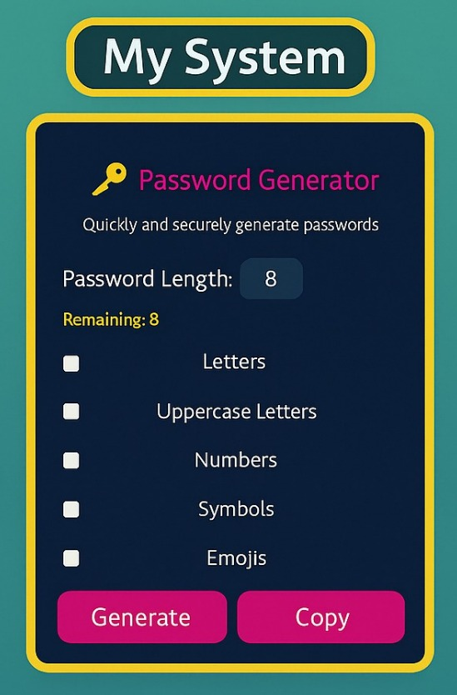
Literature Research vs Our Project
EmojiAuth (Golla & Dürmuth, 2017)
Emojis are used as password combinations.
While they are highly memorable for users, some combinations may become predictable.
The study analyzes the security of emoji sequences based on memory tendencies.
Frequently used patterns may be vulnerable to brute-force attacks.
SEntiMoji (Chen et al., 2019)
Emojis are used to perform sentiment analysis on developer comments.
They are integrated into NLP models as auxiliary features.
The goal is to classify user comments as positive or negative.
My System
Emojis are used in password generation based on semantic context.
The user's input is analyzed using NLP to extract subject-verb-object structure.
Each grammatical role is matched with a semantically appropriate emoji.
Security is verified through randomness and brute-force resistance tests.
If character counts are insufficient, the system auto-completes the rest.
Result: Meaningful, hard-to-crack, and personalized passwords are generated.

Slide 5
Project Scope
💻 Backend
Built with Python + Flask using an API-based architecture
Enables real-time password generation and evaluation
Designed for modularity and scalability
🌐 Frontend
Accessible via a browser-based, user-friendly web interface
Instantly displays emoji-based and classic password suggestions
🔧 Technology
Generates meaningful, strong, and memorable passwords from user input
Uses spaCy NLP to extract subject, verb, and object
Emoji selection is based on a structured JSON file containing:
Emoji character, name, synonyms, and category
🔐 Security
Password strength is evaluated using:
Monobit, Runs, Cumulative Sums, and Serial tests
Brute-force attack time estimation provides feedback on resilience

Slide 6
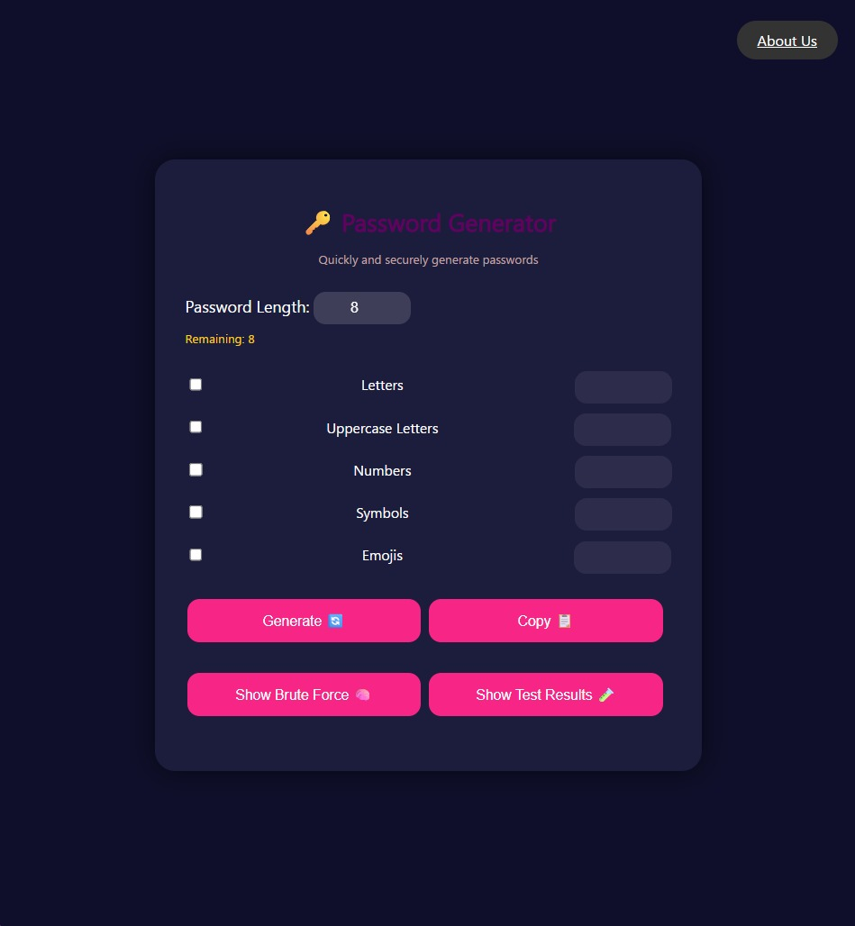
Overview of Frontend Features
Built using HTML, CSS, and JavaScript.
Responsive design with clean layout and dark theme with accent colors for interactive elements.
Emoji checkbox triggers a dynamic sentence input box.
Real-time feedback for invalid or missing inputs.
Recommended password is shown only when user selections are suboptimal.
Functional buttons for:
Password generation
Randomness testing
Brute-force estimation
Copy to clipboard

Slide 7
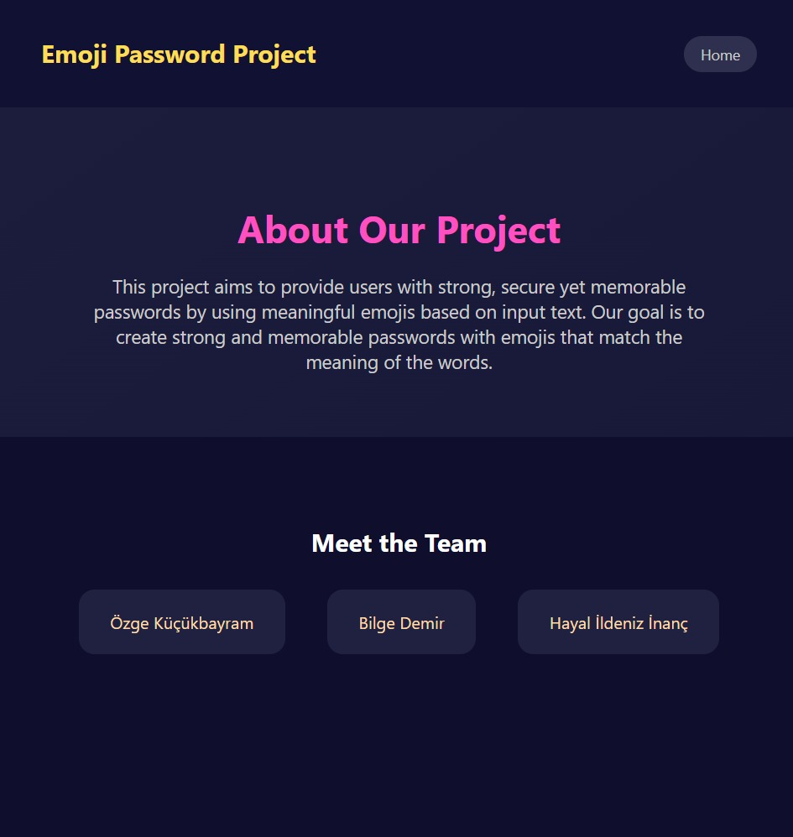
Overview of Frontend Features
About Us – Emoji Password Project
This is the About Us page of the Emoji Password Project.
Our goal is to generate secure, yet memorable passwords by combining natural language understanding with meaningful emojis. By turning words into semantically relevant emoji-based passwords, we make security both smart and user-friendly.

Slide 8
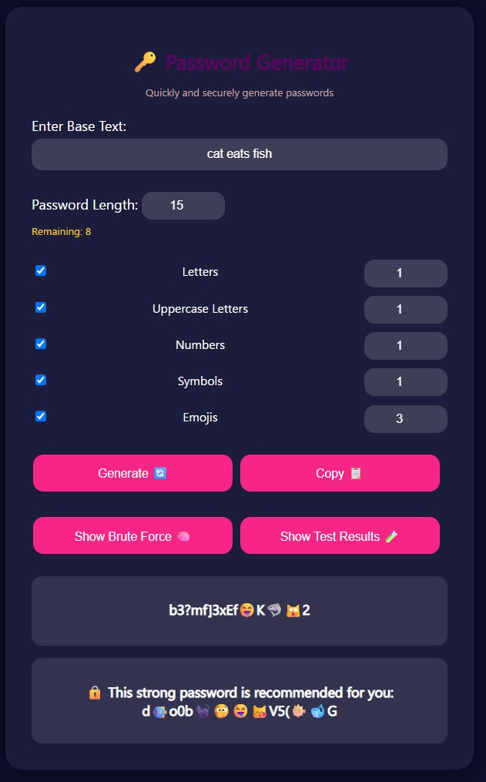
Requirements
User selects desired password length and character types (emojis, uppercase, digits, etc.).
If the emoji character type is selected, an additional text box appears for sentence input.
User inputs a sentence (e.g., "cat eats fish").
System analyzes the input using NLP.
Password is generated with grammatical emoji mapping.
Password is tested using NIST-style randomness tests.
If selection is incomplete, the system provides a recommended version.

Slide 9
IMPLEMENTATION
1) Grammatical Role Extraction with NLP
2) Word Normalization: Stemming and Fuzzy Matching
3) Semantic Mapping: 3-2-1 Priority Approach
4) Emoji JSON Creation & Loading
5) Shuffling Algorithm: Fisher-Yates Shuffle
6) Hashing with SHA-256

Slide 10
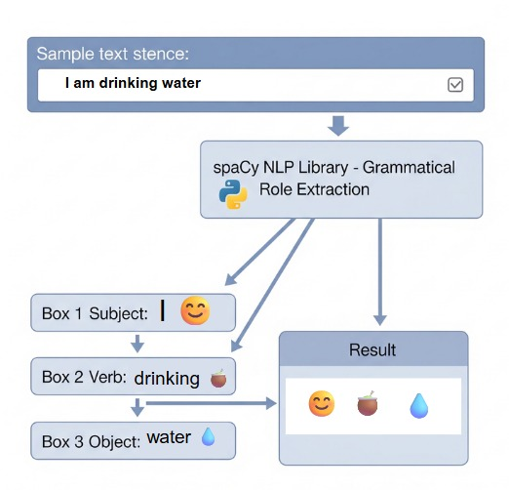
1) Grammatical Role Extraction with NLP
We use the spaCy NLP library to process user-input sentences.
The algorithm extracts Subject, Verb, and Object using token.dep_ and token.pos_.
These components form the foundation for semantic emoji matching.
This enables the generation of context-aware, meaningful, and memorable passwords.

Slide 11
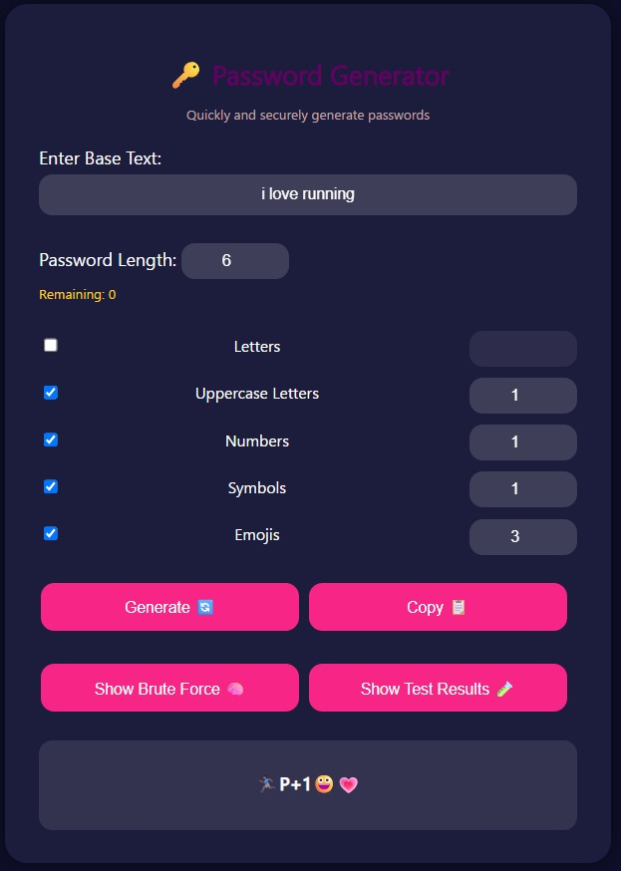
2) Word Normalization: Stemming and Fuzzy Matching
1. Stemming
Users may use different word forms that mean the same thing (for example: "smile", "smiling", "smiled").
Therefore, the system reduces words to their roots. In other words, it finds the basic form of the word that carries its meaning.
This process is performed with the apply_stemming() function that we defined in the project.
The function converts each word to its English root, so that all variations are collected in a single meaning.
📌 Purpose:
To provide correct meaning matching by reducing variations between words.
2. Fuzzy Matching
Users may sometimes misspell words (for example: "smiling" instead of "smilng").
To handle this situation, the system uses the find_closest_match() function.
This function evaluates the word entered by the user in terms of its similarity to the correct words in the system.
The closest matching correct word is automatically selected.
📌 Purpose:
To improve the user experience by providing tolerance for spelling errors.

Slide 12
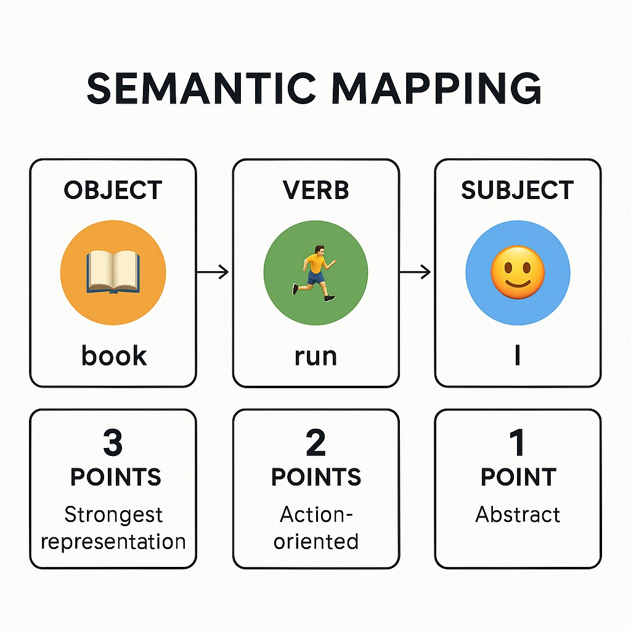
3) Semantic Mapping: 3-2-1 Priority Approach
Weighted Emoji Selection
Words corresponding to each component are matched with the most meaningful emojis from the JSON dataset. However, since their visual and semantic importance are different, different weights are given to each component:
Object words receive the highest priority of 3 points.
Predicate words are evaluated with a medium priority of 2 points.
Subject words have the lowest priority of 1 point.
This prioritization is provided by the 3-2-1 scoring strategy implemented in the get_random_emojis() function.
🎯 Purpose and Result
Thanks to this weighted distribution, object words with strong meaningfulness and visual consistency are highlighted when creating a password.
Predicates and subjects play a supporting role, ensuring that the password is both meaningful and easy to remember.
Thus, the system produces an emoji-based password that is both visually strong and preserves its semantic integrity.

Slide 13
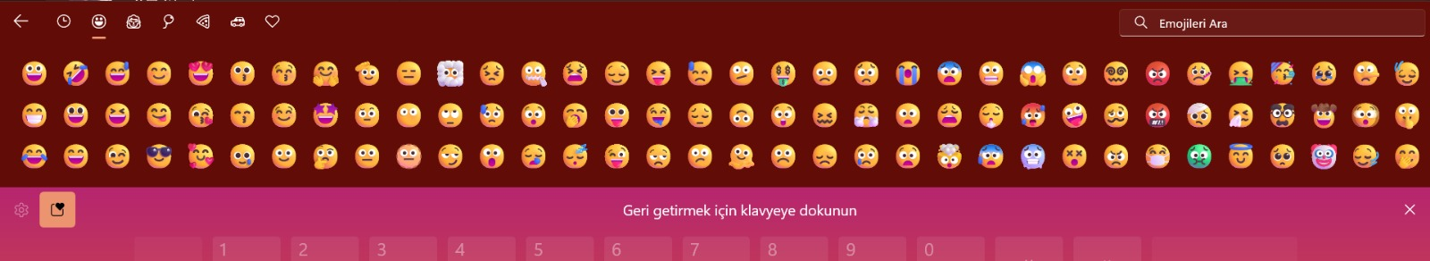
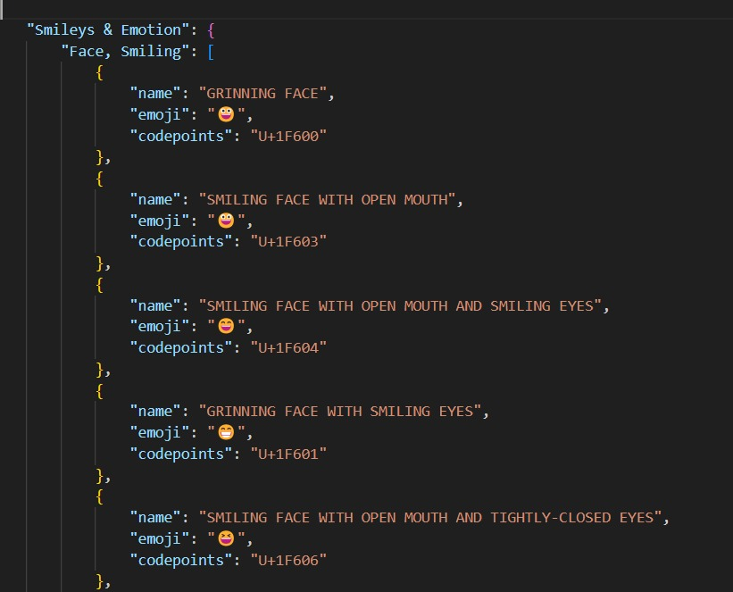
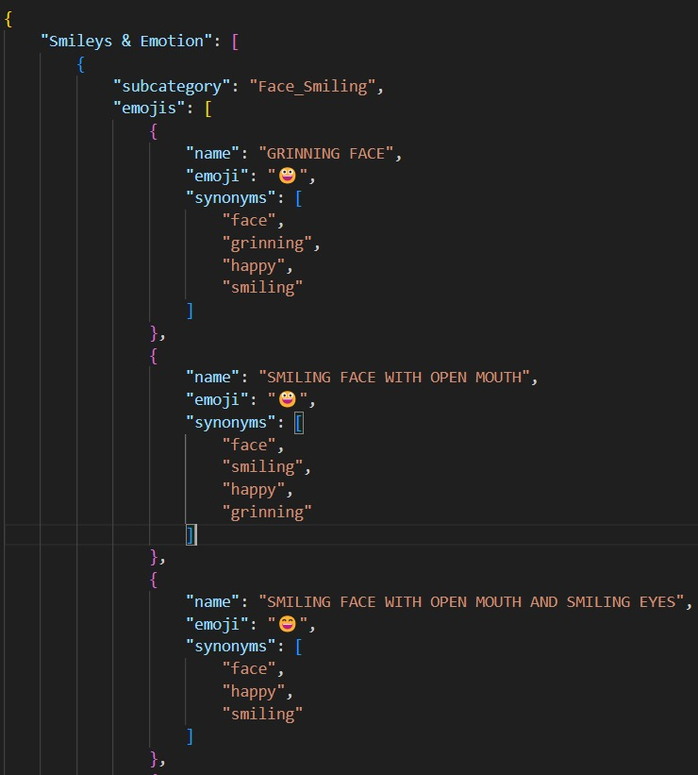
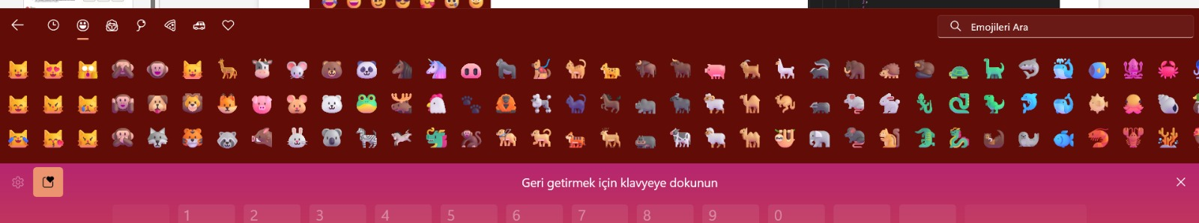
4) Emoji JSON Creation & Loading
Emoji data is provided with Unicode and open imports JSON category → subcategory → emoji storage.
WordNet and manually added synonyms for emoji.
During upload, all words were converted to lowercase and saved in the emoji_dict dictionary.
All words were transferred to the all_words group for a flexible compatibility system with RapidFuzz.
Windows 11 Emoji Keyboard

Slide 14
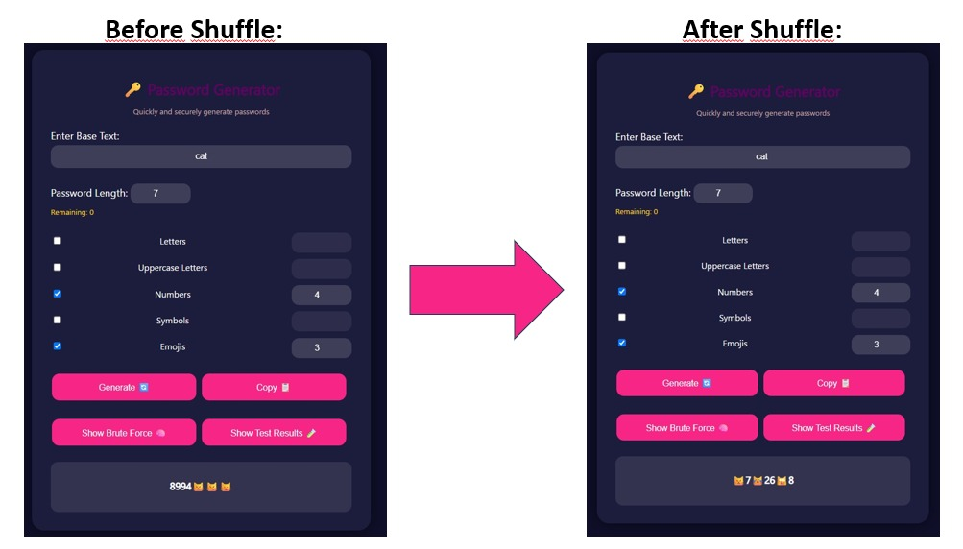
5) Shuffling Algorithm: Fisher-Yates Shuffle
In our password generation system, the Fisher-Yates algorithm is used to randomize the final list of characters.
Since this list can follow a strict pattern (e.g. emojis first, numbers next), Fisher-Yates is used to evenly shuffle the character positions, ensuring that each character has an equal chance of appearing in any given sequence.
As a result:
Sequential patterns and predictability are eliminated,
Passwords become structurally unique and statistically random,
Integrating Fisher-Yates increases entropy and resistance to pattern-based attacks with minimal computational overhead.

Slide 15
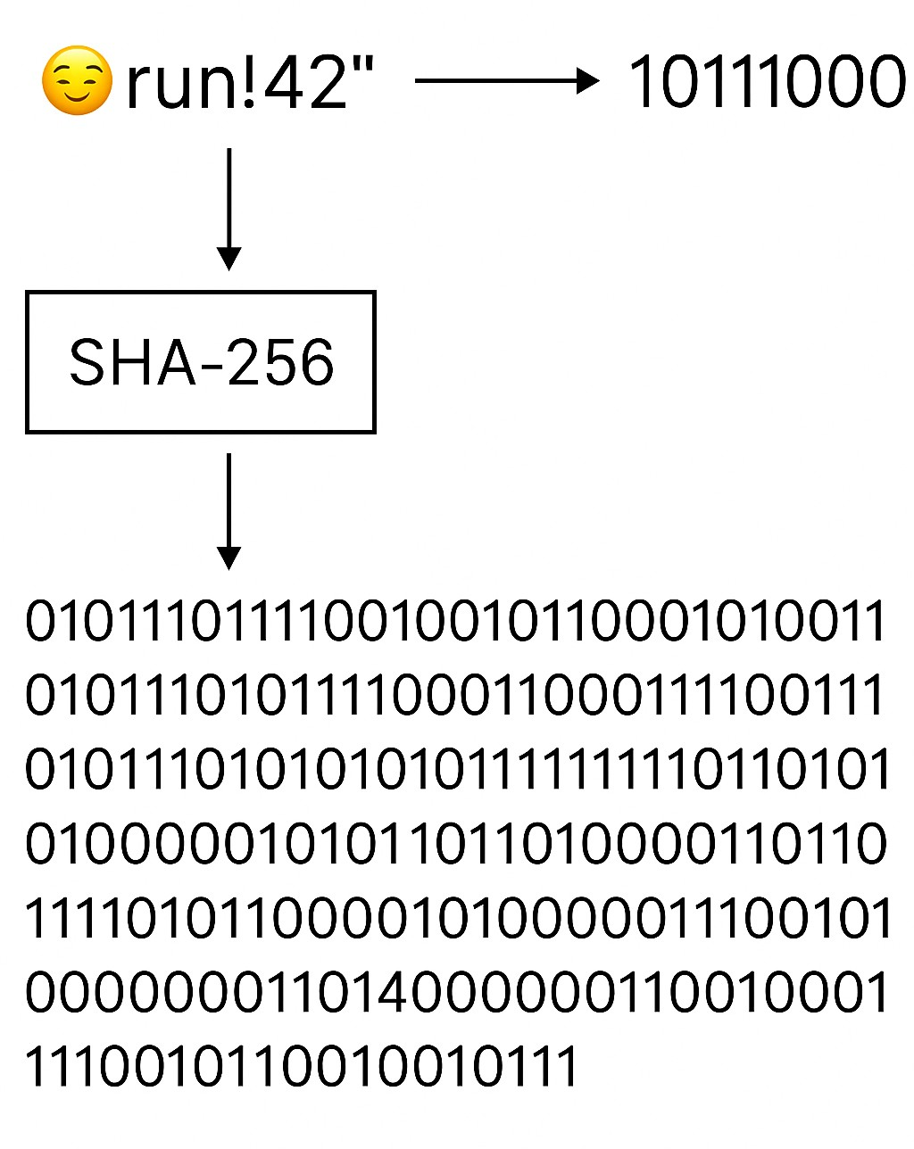
6) Hashing with SHA-256
In order to make passwords suitable for randomness tests, the SHA-256 algorithm is first applied using the hash_password() function.
SHA-256 converts all passwords with different lengths and character sets into a fixed-length (256-bit) and high-entropy output. This output is in a 64-character hexadecimal form.
The resulting hash value is converted into a bit string consisting of only 0s and 1s by the text_to_bitstring() function.
Statistical randomness tests (e.g. monobit_test(), runs_test(), cumulative_sums_test(), serial_test()) only work well on fixed-length bit strings.
Bit transformation provides a transition to the mathematical format in which the tests can be run.

Slide 16
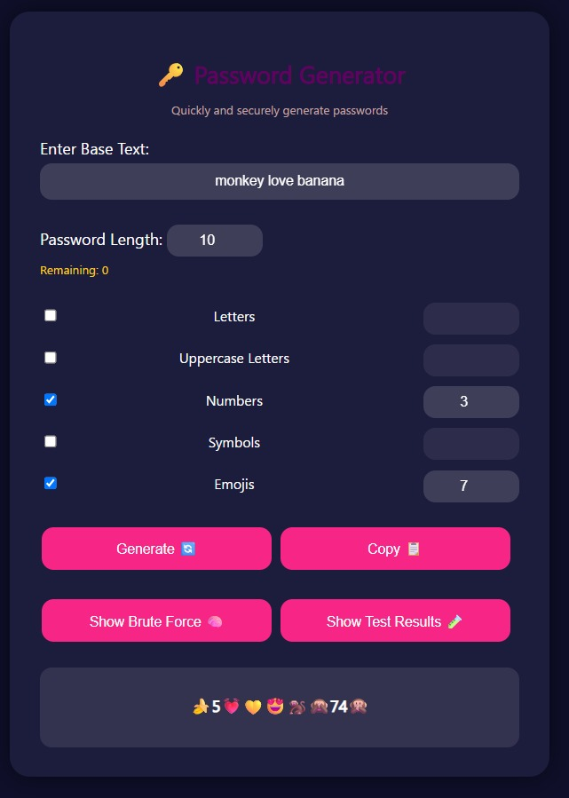
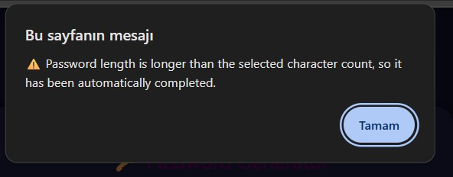
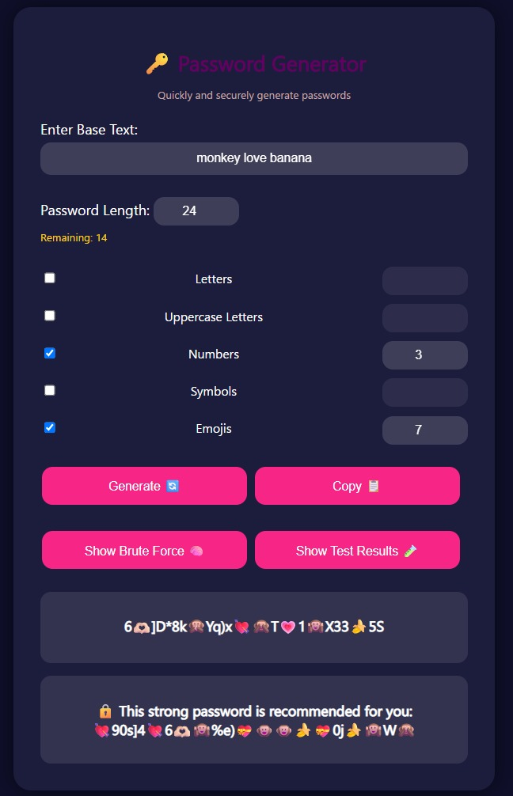
Proposed Password Generation
The system analyzes the sentence with NLP (spaCy).
Missing characters are completed with meaningful emojis.
The number of emojis must be at least 1 more than the user selection.
At least the specified number of each selected character type is added.
The password is shuffled with the Fisher–Yates algorithm for randomness.

Slide 17
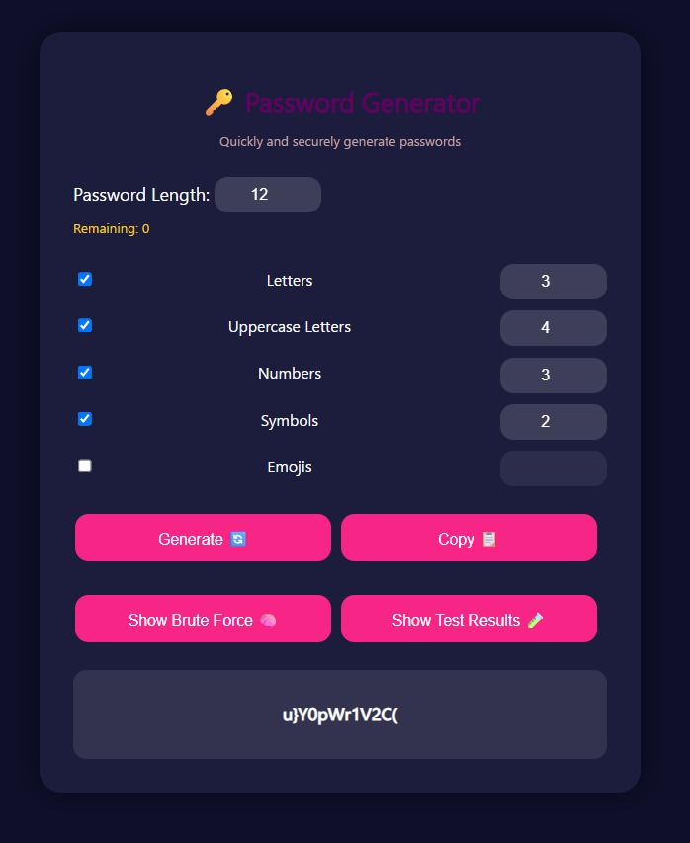
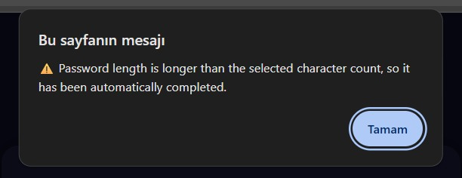
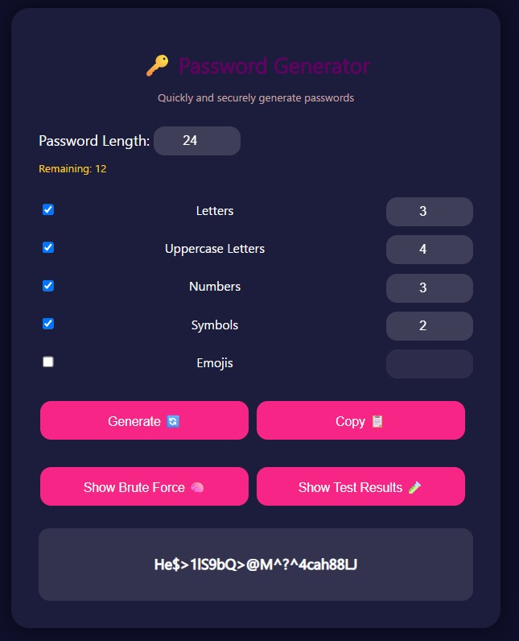
Proposed Password Generation
The system uses at least the specified number of each selected character type.
The remaining parts are completed with randomly selected letters, numbers and symbols.
All characters are selected with equal probability.
The password is shuffled with the Fisher–Yates algorithm to ensure randomness.

Slide 18
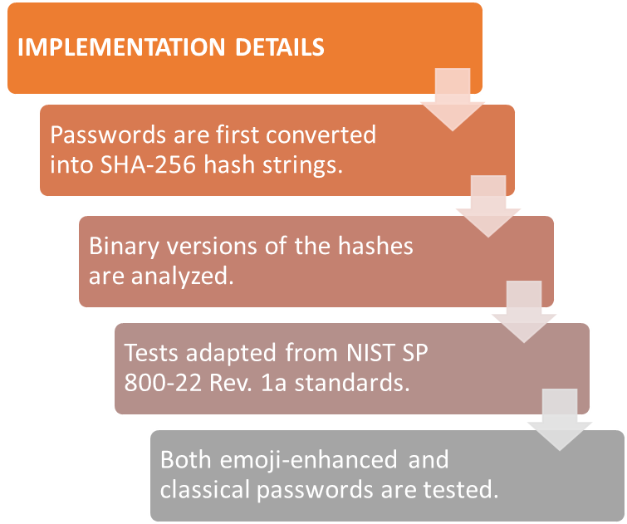
Randomness Tests
Since the emoji library used in the project is Windows-based and NIST randomness tests are Linux-based, the tests were simulated using the Python language.
In addition, since NIST tests do not support multi-byte characters such as emoji, the generated passwords were first hashed with SHA-256 and then converted to a 0-1 bit sequence to make them suitable for testing.
In this way, despite working in a Windows-based environment, all passwords were successfully subjected to NIST-compliant randomness analysis

Slide 19
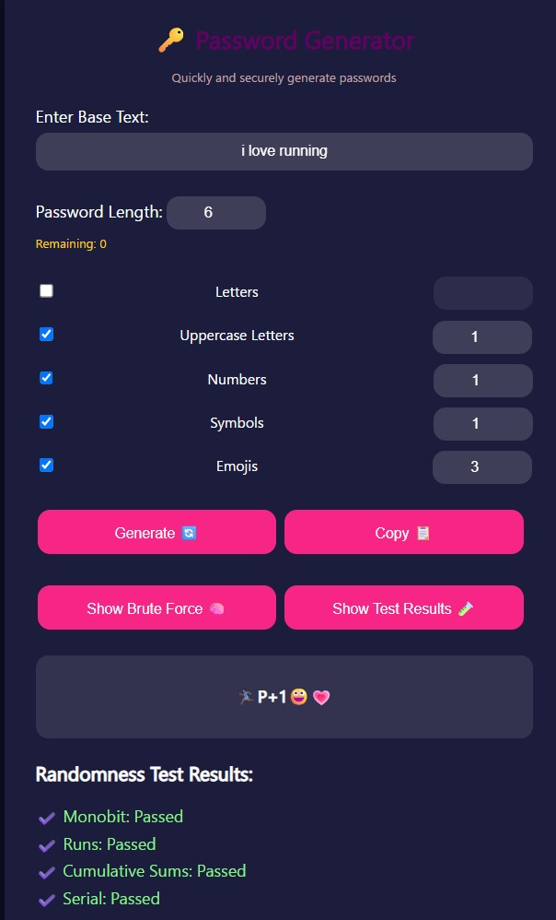
Randomness Tests
Implemented Tests
Monobit Test: Checks if the number of 0s and 1s is balanced.
Runs Test: Examines the frequency of consecutive identical bits.
Cumulative Sums Test: Evaluates the total deviations in the bit stream.
Serial Test: Analyzes the frequency of occurrence of 2-bit patterns.

Slide 20
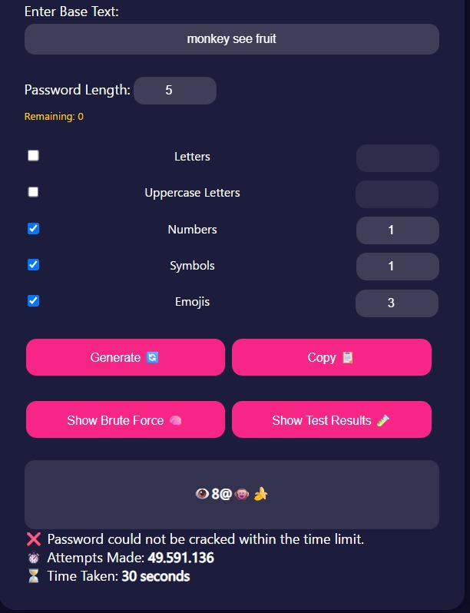
Brute Force Simulation
A custom brute-force simulation was developed to test password strength by systematically attempting all possible combinations from a known character set.
🔍 Key Insights:
Each password is tested within a 30-second time frame.
For emoji-based passwords, the attacker may know the length but not the character pool.
Without knowing that emojis are used—or which ones—the search space expands exponentially.
Even with unlimited time, the simulation fails to crack emoji-rich passwords due to the unpredictable and unknown Unicode space.
This highlights the structural resistance of semantic and emoji-based passwords to brute-force attacks.

Slide 21
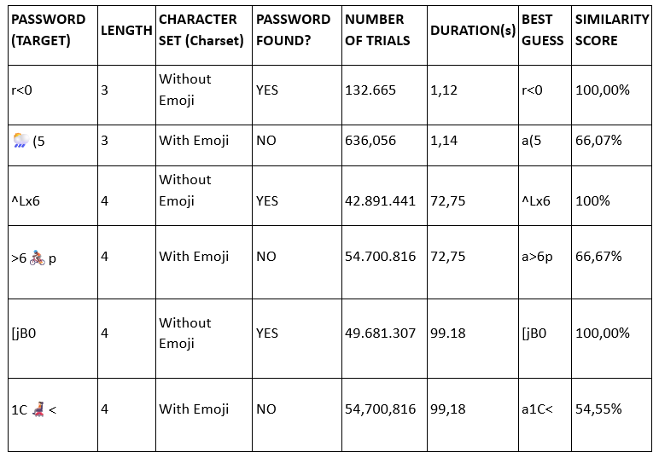
Experimental Results
Overview
Brute-force tests were performed to evaluate password strength and crackability.
Comparison focuses on passwords with emojis vs. without emojis, all tested under the same time constraints.
Conclusion
Emoji-based passwords consistently:
Were not cracked within the allowed time
Had lower similarity scores
Indicate higher unpredictability and entropy
Brute-force attacks were conducted within fixed time limits.

Slide 22

Conclusion
NLP + Emoji matching for meaningful password generation
Subject-Verb-Object analysis, priority: Object > Verb > Subject
Stem finding and fuzzy matching for error tolerance
Character completion logic:
Emojis enabled: Semantically related emojis
Emojis disabled: Random characters
Fisher-Yates + SHA-256 for strong randomness and shuffling
Passed NIST randomness tests (Monobit, Runs, etc.)
Emoji-based passwords are resistant to brute force attacks due to large Unicode pool
Web interface supports real-time generation and security feedback

Slide 23
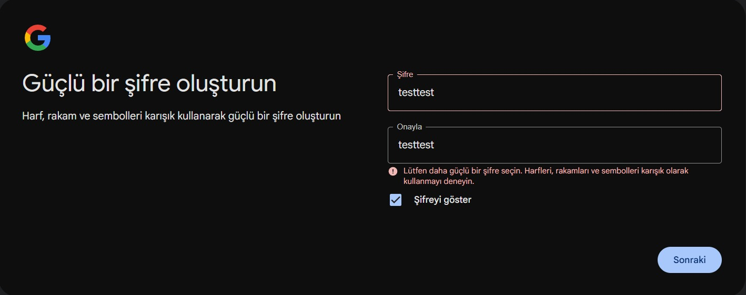
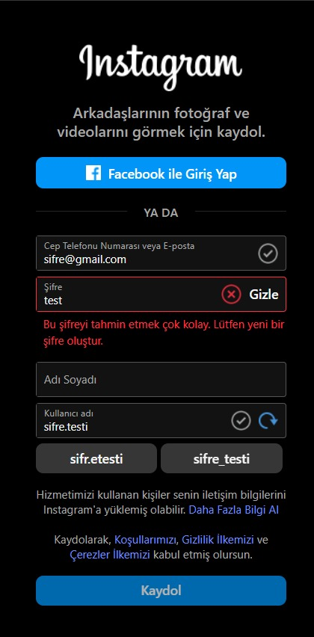
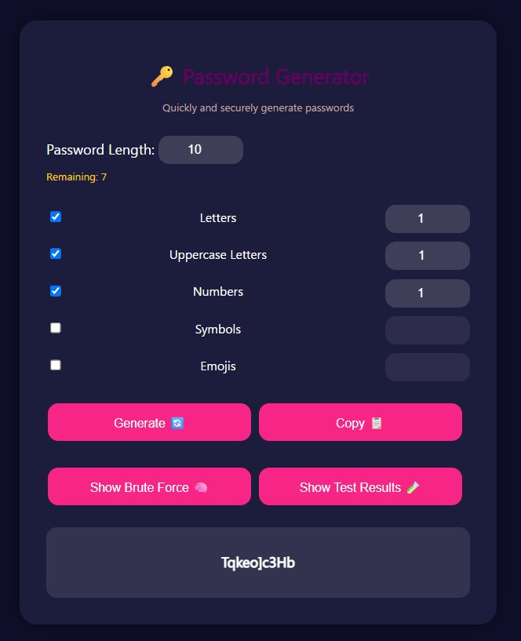
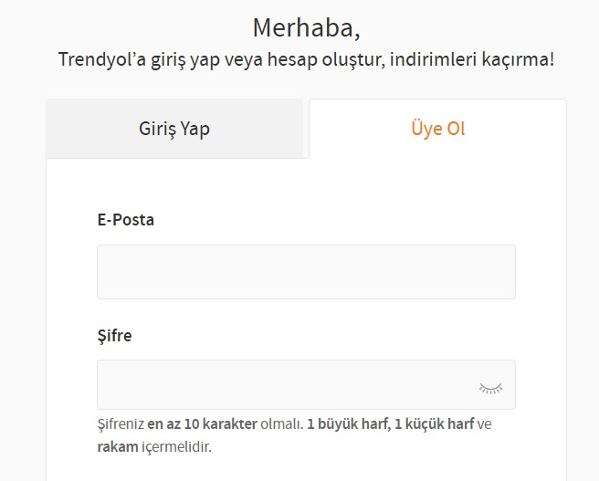
DEMO

Slide 24
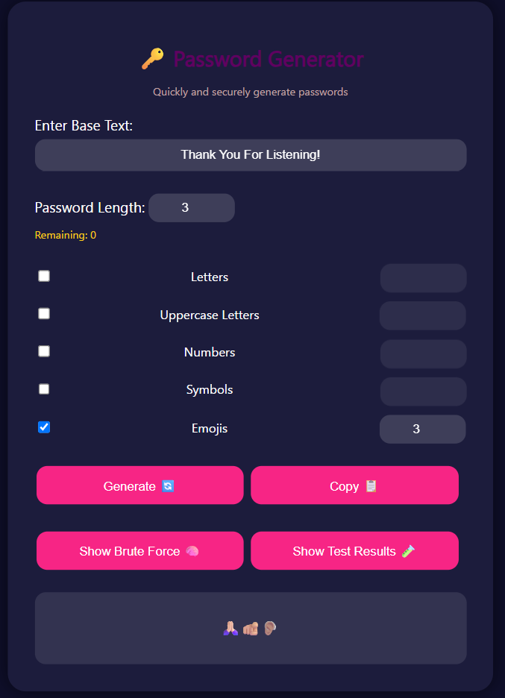
Thank You!

